Slide 1
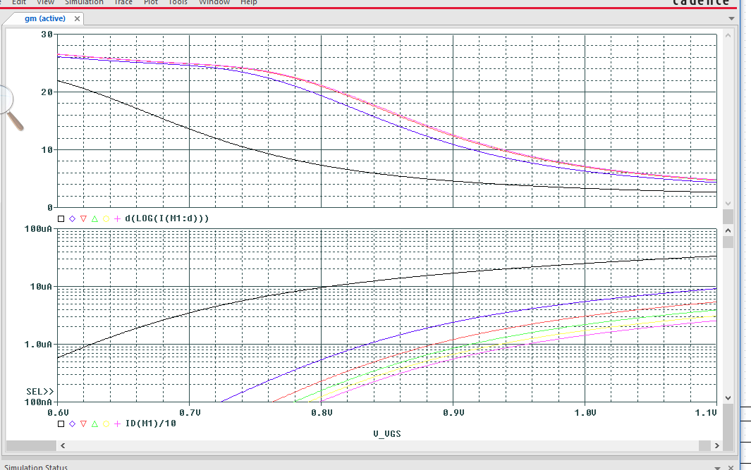
Bonus example:
gm/Id (the top plot) and drain current per um of the gate width (the bottom plot)
for a family of NMOS devices with L = 0.5, 1, 2, 3 and 4 um.
gm/Id (1/V)
L =1 um
L =0.5 um
L =0.5 um
Id/W (A/um)
L =1 um

